Slide 1
Excretory System

Slide 2
Excretion
_______________________________________– is the process by which wastes and excess substances are removed from an organism
Organs of excretion are:
________________________________________________
________________________________________________
________________________________________________
________________________________________________

Slide 3
Liver
____________________________– removes harmful substances from the blood such as bacteria, certain drugs, and hormones
The liver breaks down excess amino acids to form ________________________
Too much alcohol can lead to ________________________________________________________________________________________________________
___________________________________is considered an excretory product of the liver

Slide 4
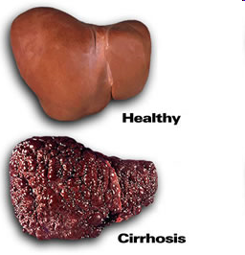
A healthy liver and the liver of a person with cirrhosis

Slide 5
Urinary System
_______________________________________________– filter urea from the blood to make urine. Contain nephrons, which are tiny filtering units
_______________________________________________– tube through which urine passes from each kidney to the urinary bladder
______________________________________– where urine is stored
______________________________________– the tube that carries urine from the bladder to the outside of the body

Slide 6
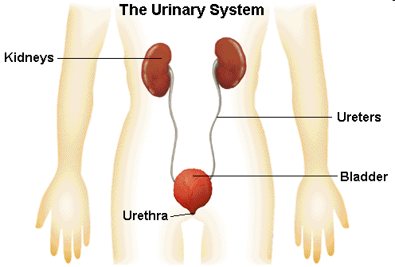

Slide 7
Lungs
__________________________________________– rid the body of carbon dioxide and water (water vapor)

Slide 8
Skin
_______________________________- major role in excretion is removal of excess heat
When the body becomes too warm, extra heat is lost
________________________________________of sweat removes heat and cools the body

Slide 9
The skin is the largest organ in the body
It contains ____________________________________________________through which sweat is released
Sweat is made up of:
98% water
2% salt
Small amounts of urea

Slide 10
Excretory Disorders
______________________________________________- result when urine becomes too concentrated and substances in the urine crystallize to form stones
______________________________________________– results when the kidneys fail to function correctly which leads to abnormal levels of fluids in the body

Slide 11
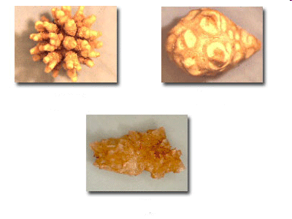
Examples of kidney stones

Slide 12
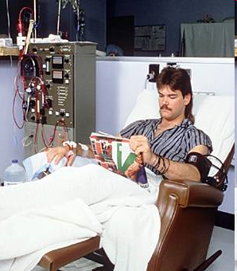
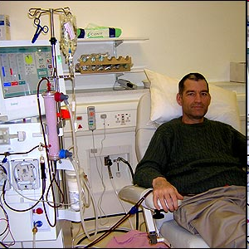
Kidney dialysis averages 4 hours per session, 3 times per week.

Slide 13
How do I keep the urinary system healthy?
Drink at least _____________________________________________of water a day
Limit your intake of caffeine and soft drinks
This can increase water loss through urine, thus ___________________________________________your body

Slide 14
Urinary System Video Clip: https://www.youtube.com/watch?v=2_7Q1xQ-NWU

