Slide 1
Living Things

Slide 2
How do we know is something is ‘living’?
All living things are characterised as being able to do ____________________________ things
These are usually remembered by the mnemonic _________________________________________
M
R
S
N
E
R
G
Can you guess what these letters stand for?

Slide 3
The 7 characteristics of Living Things
__________________________________– Animals move to find food and keep away from predators, plants move to face the light
_________________________________– the ability to produce offspring to keep the species in existence
_________________________________– responding and reacting to the environment
_________________________________– Animals need food for respiration, plants need minerals from the soil
_________________________________– Getting rid of waste
_________________________________– Turning food into energy
_________________________________– Growing larger and stronger → becoming adult size

Slide 4
Classification of Living Things
Everything that is living can be sorted into these 5 kingdoms
Kingdom Moneran
Protist Kingdom
Fungi Kingdom
Animal Kingdom
Plant Kingdom

Slide 5
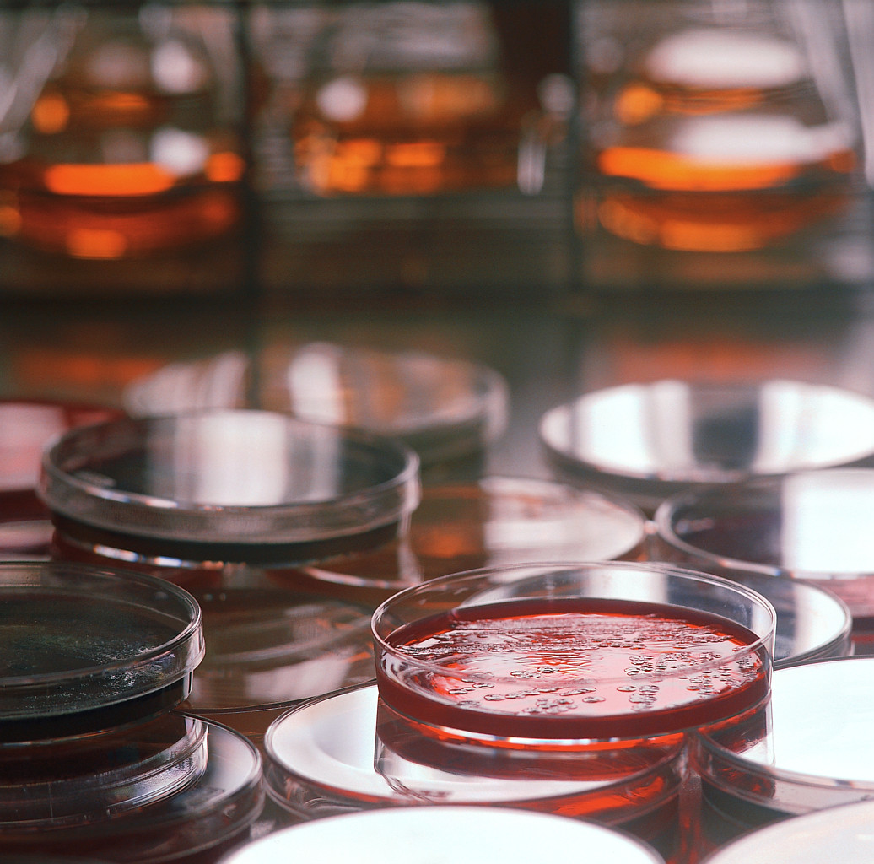
________________________Moneran
Tiny, single-celled organisms
_________________________________ have a nucleus
E.g. bacteria

Slide 6
________________________Kingdom
Single-celled organisms ______________________________________________________________________________________________
Live in damp places of water
E.g. amoeba

Slide 7
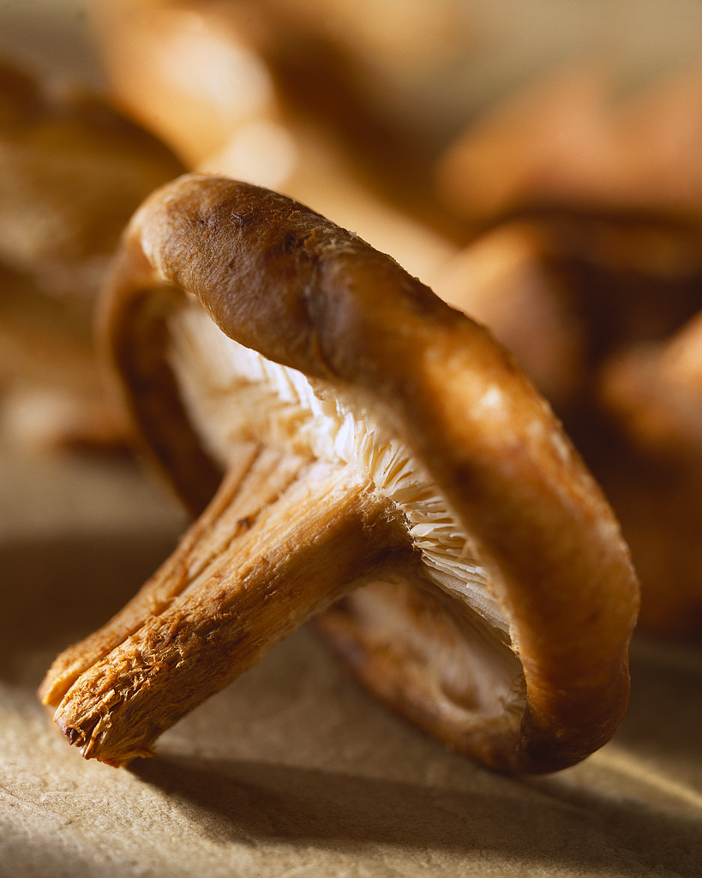
____________________________Kingdom
Body is made up of a network of threads called hyphae
E.g _________________________, ___________________________________________________

Slide 8
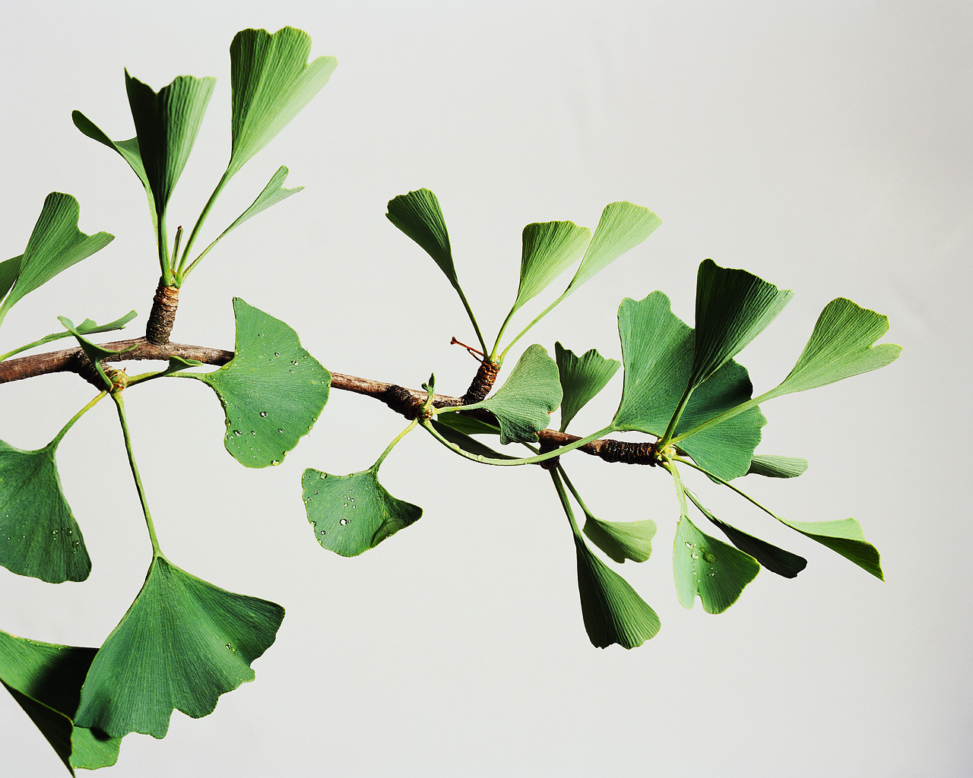
____________________________Kingdom
Multicellular – made up of lots of cells
_________________________________________________________________________________________________by photosynthesis
Lots of examples: flowering plants / non-flowering plants

Slide 9
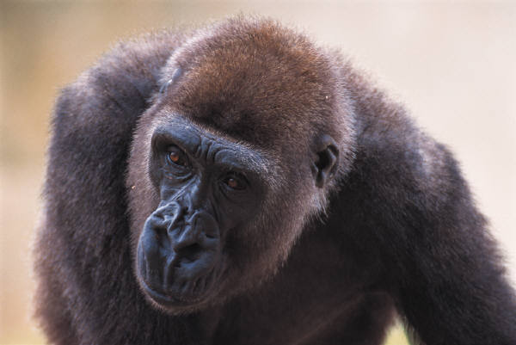
_____________________________Kingdom
Multicellular – made up of may specialised cells
_________________________________________________________________________________________________________________________________________________
Can be further classified into ___________________________________ and ____________________________________________________ then into classes such as amphibians, reptiles, birds, mammals

Slide 10
Body Symmetry of Animals

Slide 11
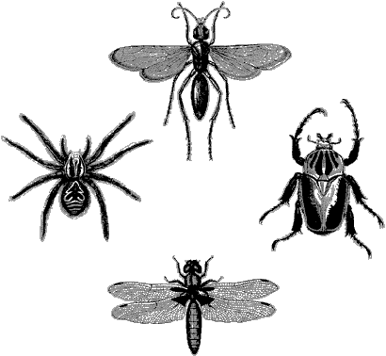
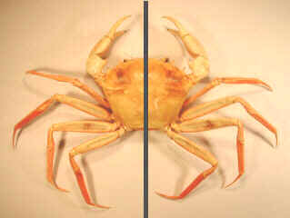
____________________Symmetry: a single plane divides body into _____________________________________________________________________________________

Slide 12
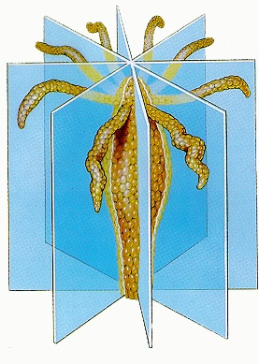
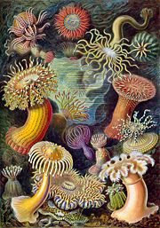
___________________________Symmetry: can be ___________________________________________________________that allow for nearly ______________ __halves

Slide 13
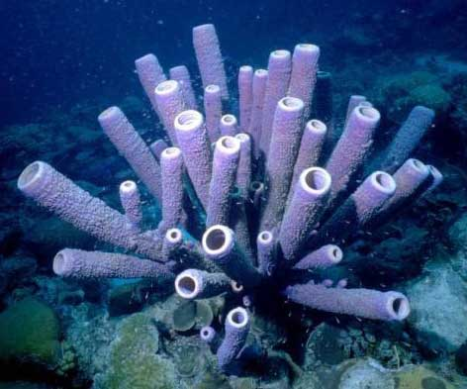
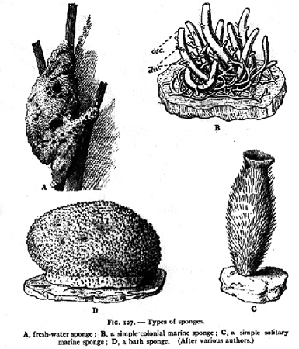
_________________________________:
___________________________________________ into mirror images

