Slide 1
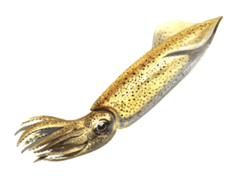
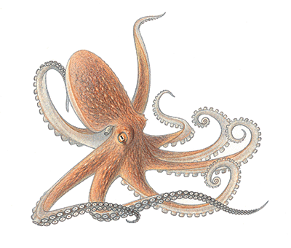
Mollusks

Slide 2
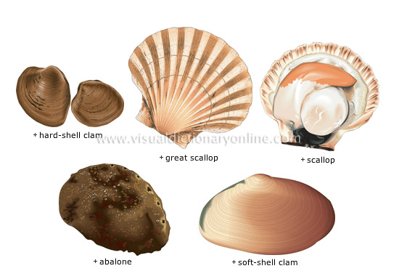
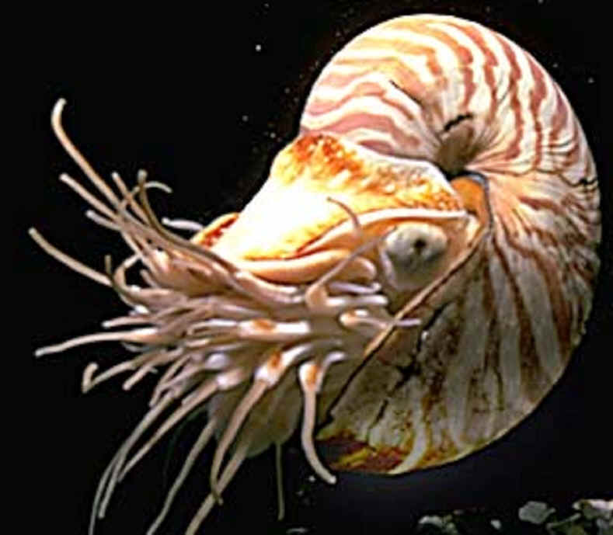
Phylum Mollusca
Includes snails and slugs, oysters and clams, and octopuses and squids.
Bivalves
Nautilus

Slide 3
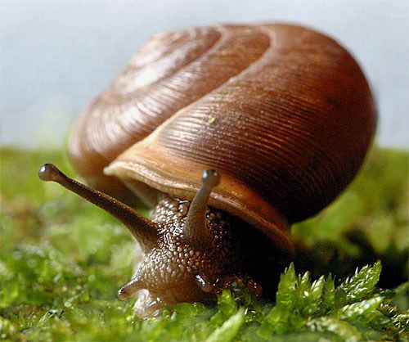
Characteristics
Soft-bodied invertebrate
Covered with protective mantle that may or may not form a hard, calcium carbonate shell
Second largest animal phylum
Have a muscular foot for movement which is modified into tentacles for squid & octopus

Slide 4
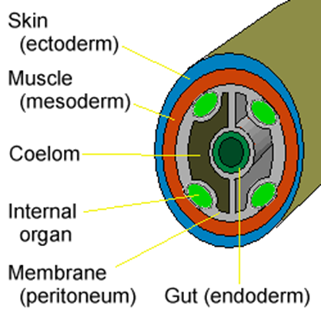
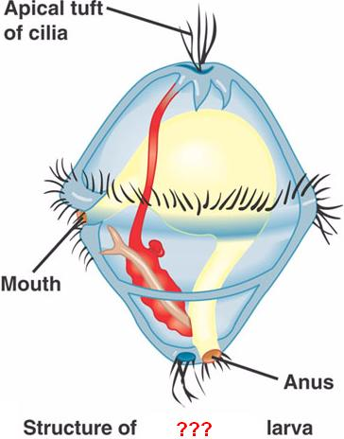
Characteristics
Complete, one-way digestive tract with a mouth & anus
Have a fully-lined coelom
Cephalization - have a distinct head with sense organs & brain
Have a scraping, mouth-like structure called the radula
Go through free-swimming larval stage called trochophore

Slide 5
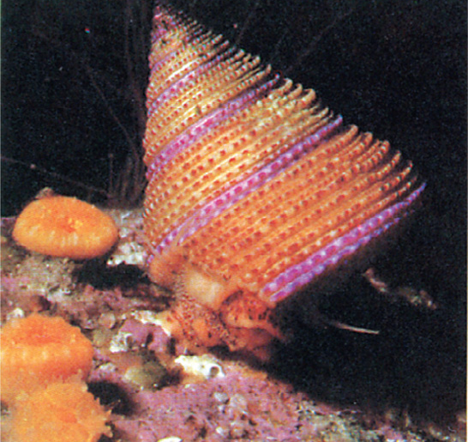
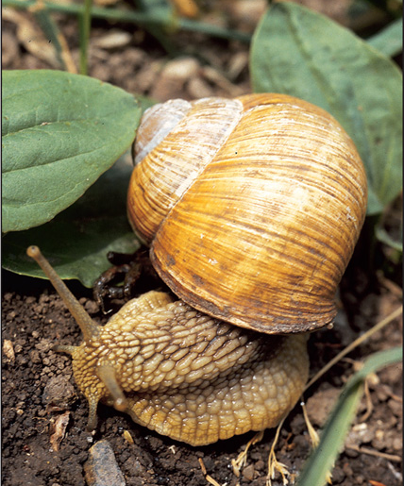
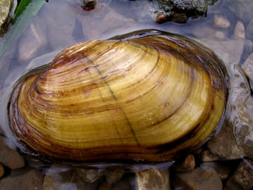
Phylum Mollusca
Most mollusks are marine
Some gastropods and bivalves inhabit freshwater
A few gastropods (slugs & snails) are terrestrial.

Slide 6
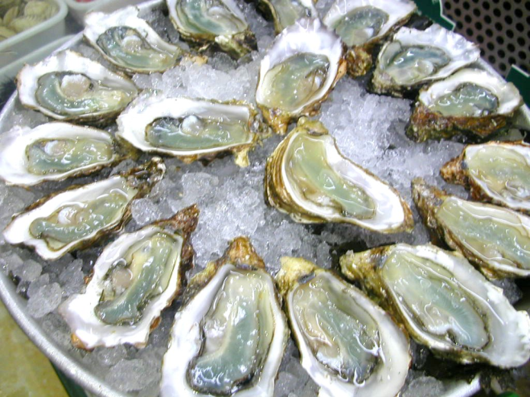
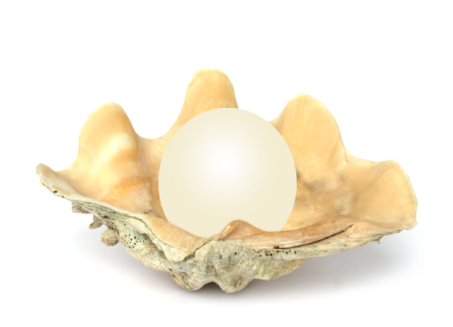
Humans & Mollusks
Uses:
As food – mussels, clams, oysters, abalone, calamari (squid), octopus, escargot (snails), etc.
Pearls – formed in oysters and clams.
Shiny inner layer of some shells used to make buttons.

Slide 7
Mollusk Pests
Shipworms – burrow through wood, including docks & ships.
Terrestrial snails and slugs damage garden plants.
Mollusks serve as an intermediate host for many parasites.
Zebra mussels – accidentally introduced into the Great Lakes and reeking havoc with the ecosystem.

Slide 8
Mollusk Body Plan
All mollusks have a similar body plan with three main parts:
Muscular foot
Visceral mass – containing digestive, circulatory, respiratory and reproductive organs.
Mantle – houses the gills and in some secretes a protective shell over the visceral mass.

Slide 9
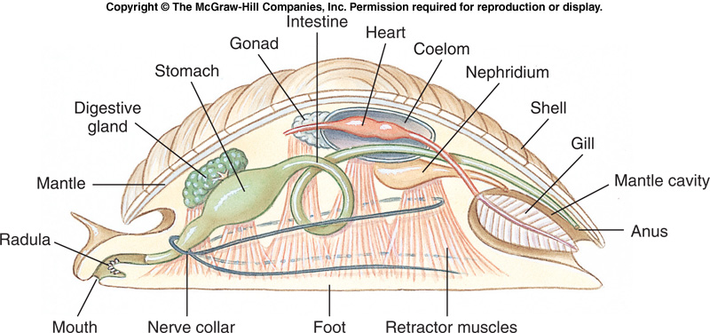
Mollusk Body Plan
Most mollusks have separate sexes with gonads located in the visceral mass.

Slide 10
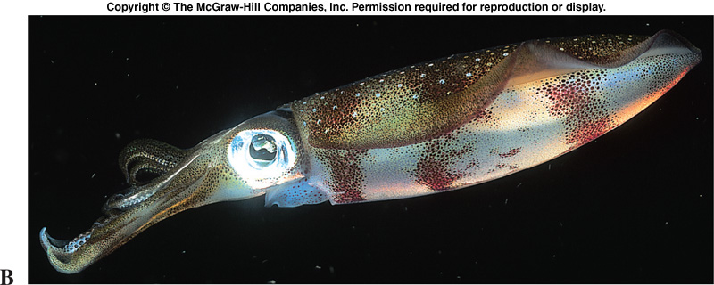
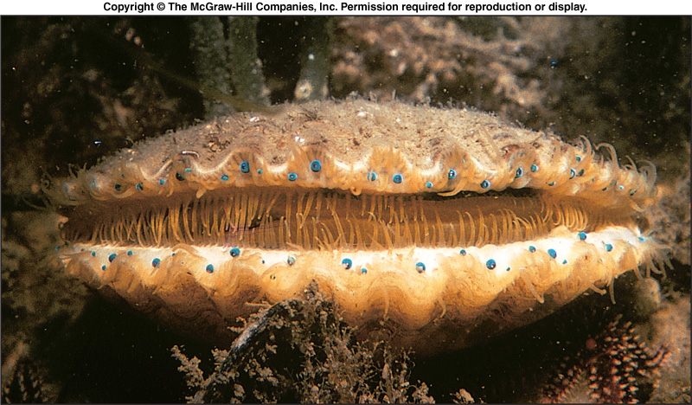
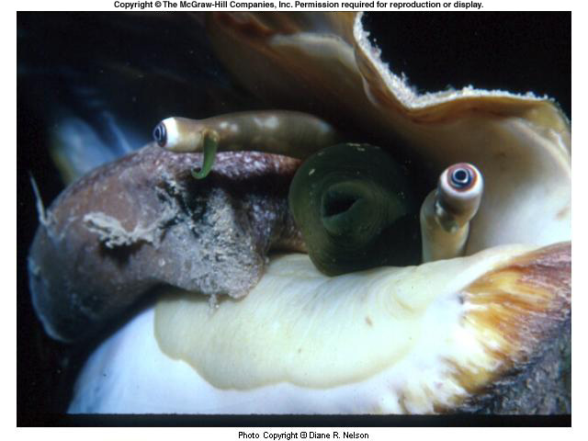
Head-Foot Region
Most mollusks have well developed head ends with sensory structures that may be simple light detectors or complex eyes (cephalopods).

Slide 11
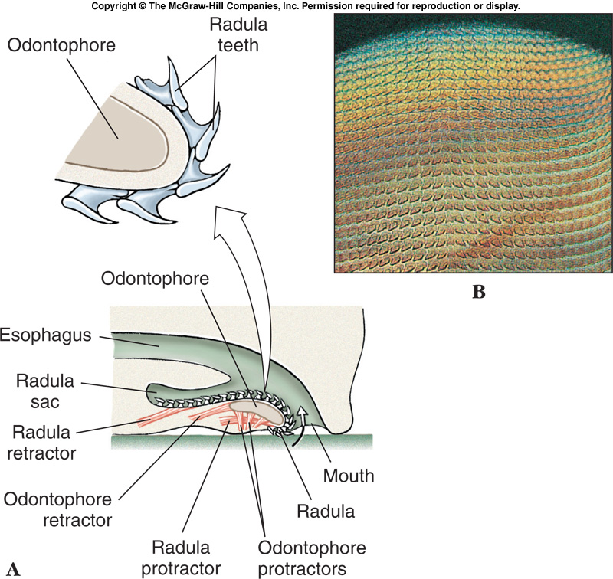
Head-Foot Region
The radula is a rasping, tongue like feeding structure found in most mollusks except bivalves.
Has tiny rows of teeth for scraping.

Slide 12
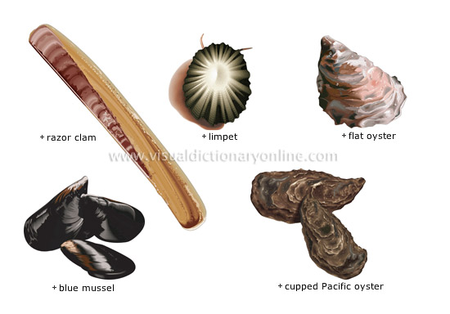
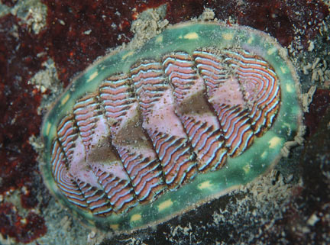
Shells
Found in snails, bivalve mollusks, chitons, and nautilus
Made of calcium carbonate (limestone)
Secreted by the mantle

Slide 13
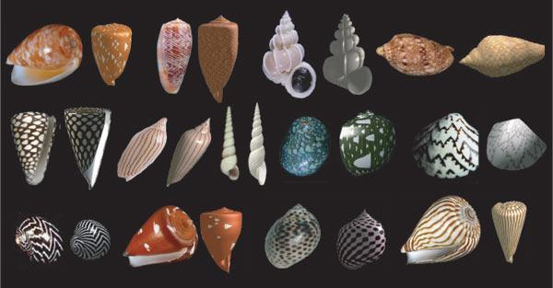

Slide 14
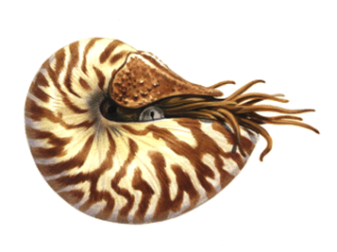
Internal Structure & Function
Many mollusks have an open circulatory system with a pumping heart, blood vessels and blood sinuses.
Most cephalopods (squid & octopus) have a closed circulatory system with a heart, blood vessels and capillaries.

Slide 15
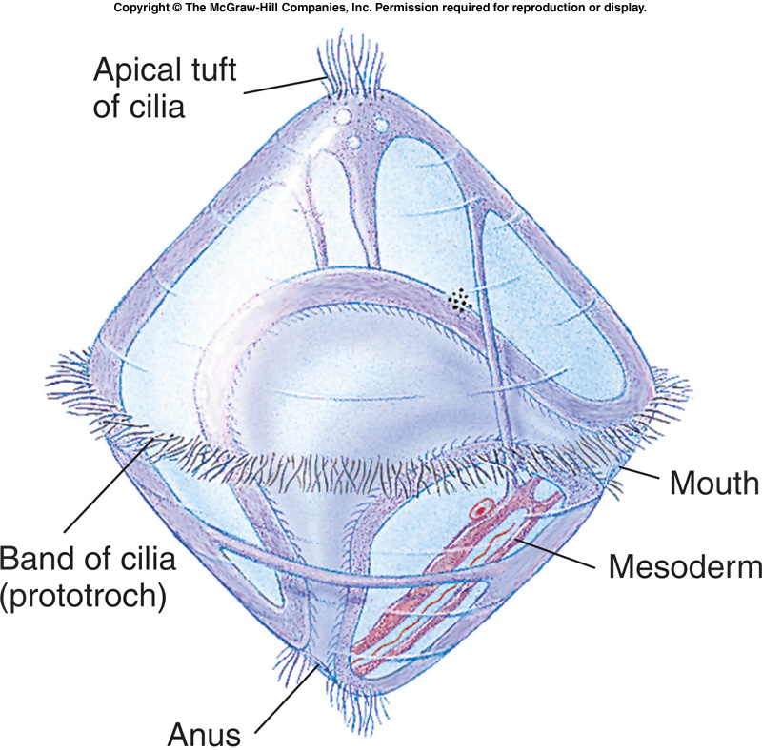
Mollusk Life Cycle
Most mollusks are dioecious (separate sexes)
Some are hermaphroditic
The life cycle of many mollusks includes a free swimming, ciliated larval stage called a TROCHOPHORE

Slide 16
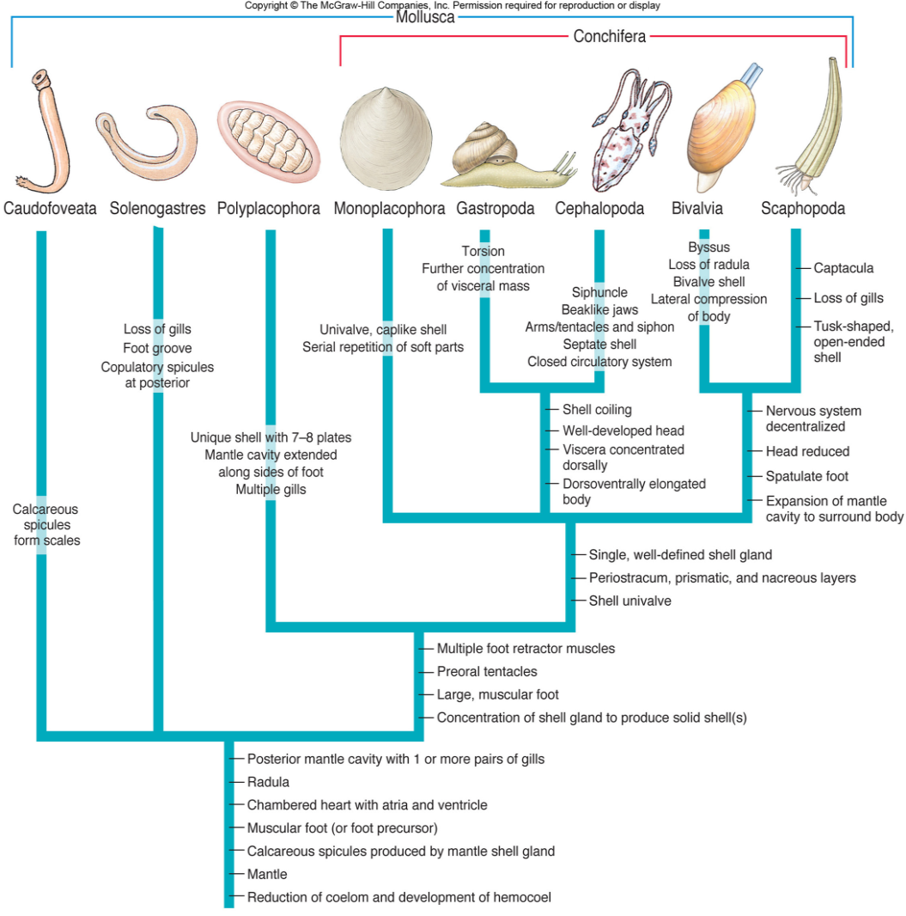
Major Mollusk Classes
Four major classes of mollusks:
Class Polyplacophora – the chitons
Class Gastropoda – snails & slugs
Class Bivalvia – clams, mussels, oysters
Class Cephalopoda – octopus & squid

Slide 17
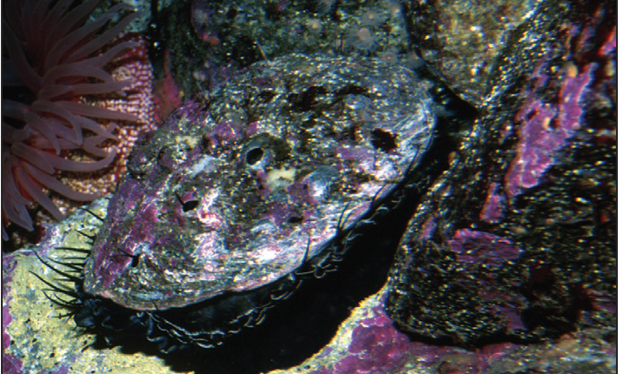
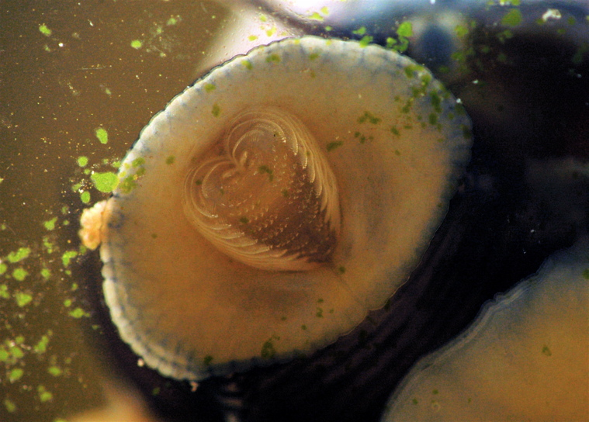
Gastropod Feeding Habits
Most gastropods are herbivores and feed by scraping off algae using the radula.
Some are scavengers of dead organisms
Others are carnivores that drill into other mollusks

Slide 18
Protection
Color changes effected by chromatophores (pigment cells)
Allows them to blend into their background
Squirting out water by jet propulsion helps escape predators
Squids also release an inky substance into the water

