Slide 1
Respiratory System

Slide 2
Respiration in Action
https://www.youtube.com/watch?v=hc1YtXc_84A

Slide 3
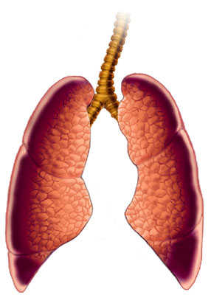
Respiratory System
Defn: ________________________________________________________________________________________________________________________________________________________________________

Slide 4
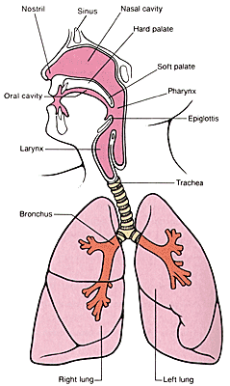
Parts of the Respiratory System
________________________– Where air enters the body. Air is moistened and filtered.
______________________ – Where air enters the body
________________________– Another name for the throat cavity
_________________________– Voice Box

Slide 5
Parts of the Respiratory System
________________________– The flap of skin that covers the trachea.
_________________________– Directs air into the lungs. Has rings of cartilage.

Slide 6
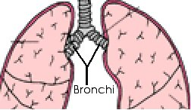
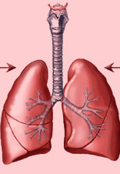
Parts of the Respiratory System
_________________________– Passages through which air enters the lungs
_________________________– Transfer oxygen into the blood and remove carbon dioxide from the lungs

Slide 7
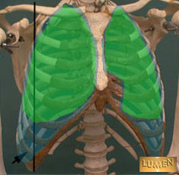
Parts of the Respiratory System
_________________________– The outer lining of the lungs

Slide 8
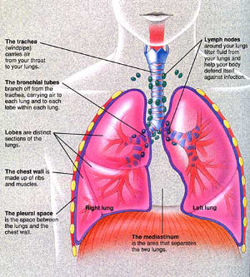
Parts of the Respiratory System
_________________________– A large dome shaped muscle that separates the lungs from the abdomen

Slide 9
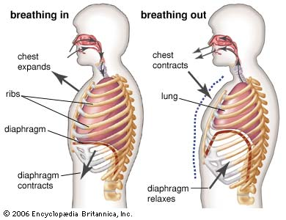
How the Diaphragm Works

Slide 10
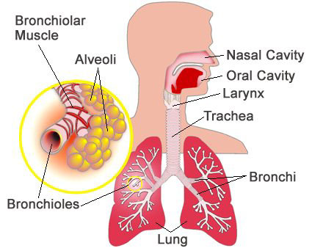
Parts of the Respiratory System
_______________________________________________– Tubes running from the trachea to the lungs

Slide 11
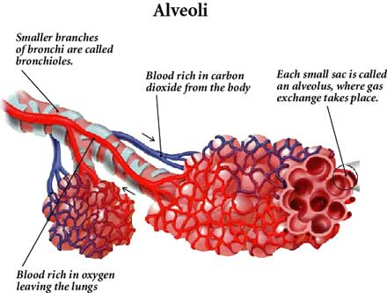
Parts of the Respiratory System
________________________________________– Tiny air sacs in the lungs. Surrounded by capillaries where gas exchange takes place.

Slide 12
Problems of the Respiratory System
___________________________________________________: Caused by a virus; cough, runny nose, aches fever
________________________________________________: Bacterial lung infection
________________________________________________: Sneezing, itchy eyes, runny nose, hives; caused by a reaction to a substance
________________________________________________: Lung infection by bacteria or viruses; fever, chest pain, difficulty breathing

Slide 13
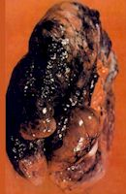
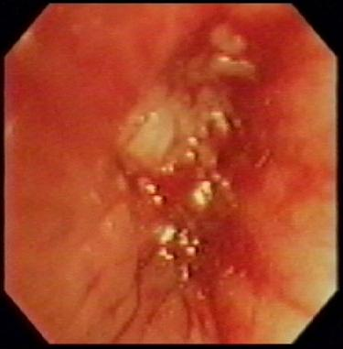
Problems of the Respiratory System
____________________________________________________: Alveoli destroyed; often caused by smoking
Graphic Picture!!!

Slide 14
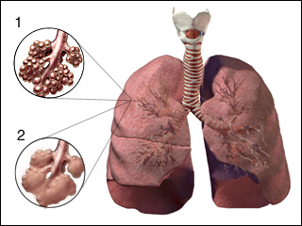
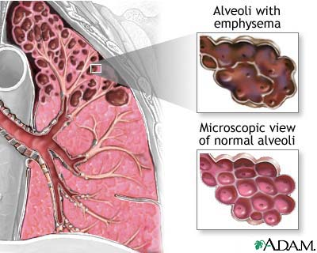
Problems of the Respiratory System
___________________________________________________: Alveoli destroyed; extreme difficulty breathing; often fatal

Slide 15
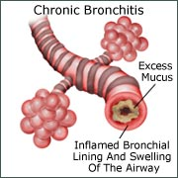
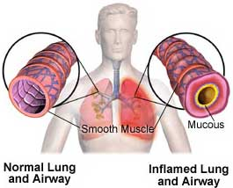
Problems of the Respiratory System
______________________________: Swelling of the bronchi due to infection; cough fever, tightness in chest
_____________________________: Bronchial swelling and blockage; wheezing, short breath, coughing

