Slide 1
Skeletal System

Slide 2
4/20/17 | Skeletal System
Aim: | I can understand the Skeletal System.
Do Now: | How many bones do you think are in the human body? What is the function of the skeletal system?
Homework: | ~ Exit Project due May 12th ~ Work on your data analysis. ~ http://owncscyriac.weebly.com

Slide 3
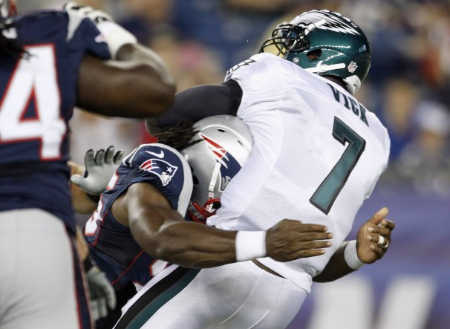
5 Main Functions
1. Provides support for the body
2. Protects internal organs from damage.

Slide 4
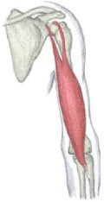
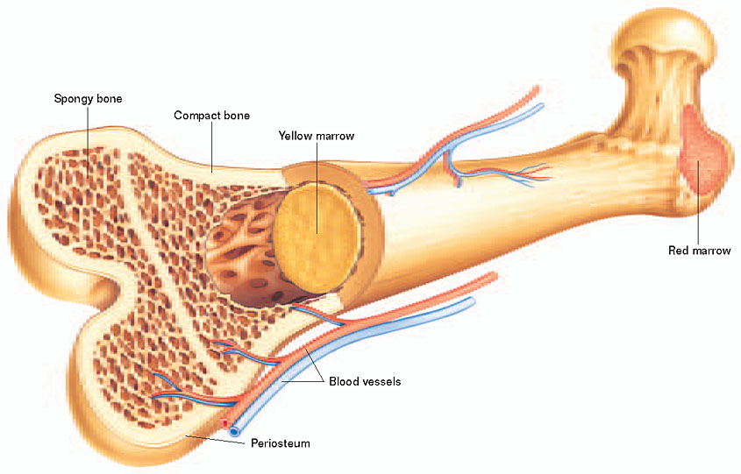
3. Acts as framework for attached muscles.
4. Production of red and white blood cells

Slide 5
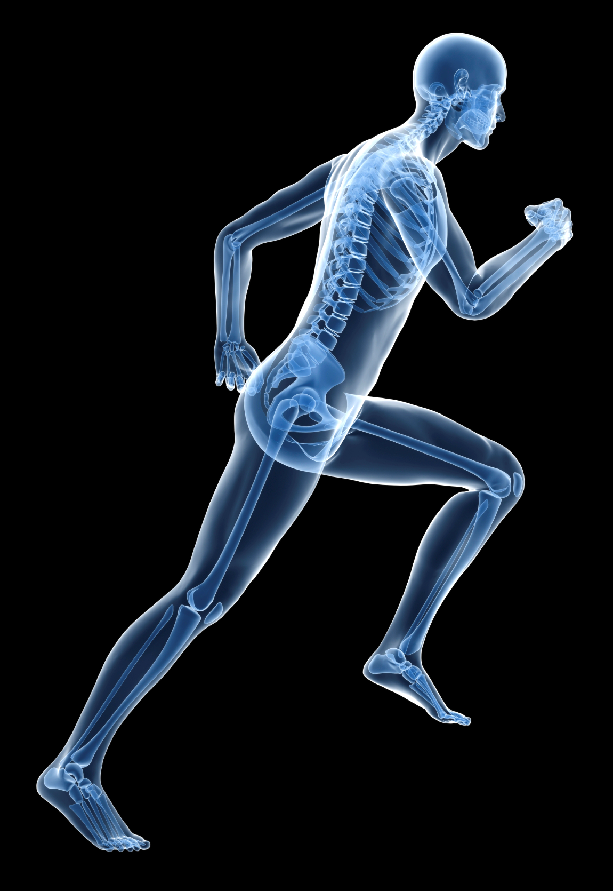
5. Allows movement of
limbs

Slide 6
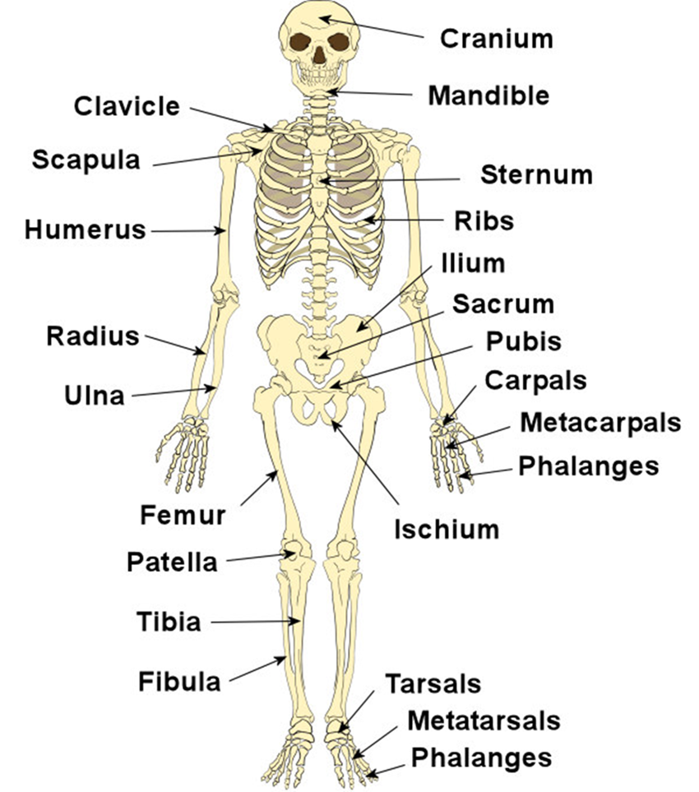
2 main parts of skeletal system
1. Axial
Center of skeleton
Ribs, sternum,
skull, and spine
2. Appendicular
All the limbs outside
the axial skeleton

Slide 7
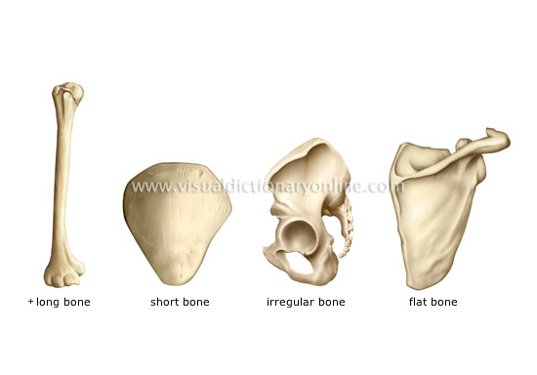
4 Types of Bones
1. Long Bones
Humerus, Femur (arm and leg bones)
2. Short Bones
Found in wrist and ankle (carpals and tarsals)
3. Flat bones
Ribs, Scapula
4. Irregular Bones
Vertebrae

Slide 8
2 Layers of Bone
1. Periosteum – Outer layer
Dense, thick, and hard
2. Endosteum – Inner layer
Less dense bone that is sponge like.

Slide 9
Types of Joints
1. Joint – a location in the body where two or more bones meet to enable movement.
2. Ball and Socket Joint
Enables wide range of motion
Example – shoulder and hip
3. Hinge Joint
Lesser range of motion than ball and socket
Example elbow and knee
4. Pivot Joint
Enables rotation of head and forearm

Slide 10
3 Types of Connective Tissue
1. Cartilage – strong, flexible tissue that makes up soft parts of body.
Tip of nose, ear
All bones (from the time of birth) start as cartilage.
As cartilage hardens, it turns to bone. This process is called ossification.

Slide 11
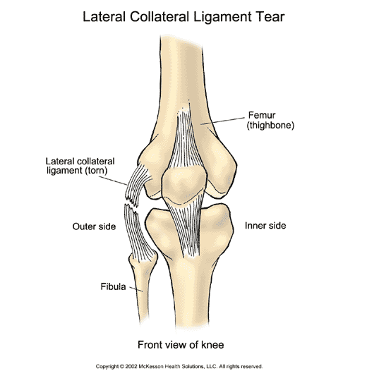
3 Types of Connective Tissue
2. Ligament – band of fibrous, elastic tissue that connects BONE to BONE!

Slide 12
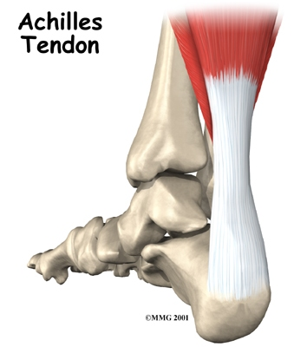
3 Types of Connective Tissue
3. Tendon – fibrous cord that attaches MUSCLE to BONE!
Achilles tendon in back of your foot

Slide 13
Problems of Skeletal System
1. Fracture – any type of break in the bone
4 types
1a. Hairline Fracture – parts of the bone do not separate

Slide 14
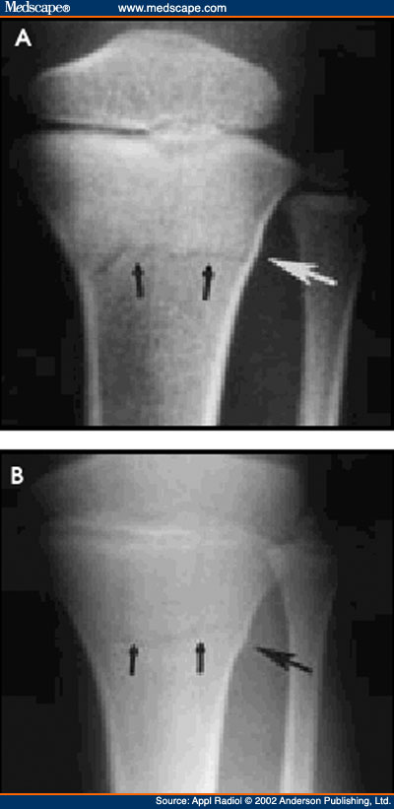

Slide 15
Problems of Skeletal System
1b. Transverse Fracture – when the break is completely across the bone

Slide 16
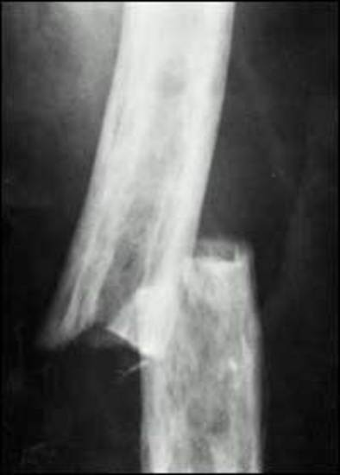

Slide 17
Problems of Skeletal System
1c. Comminuted Fracture – bone shatters in more than 2 pieces

Slide 18
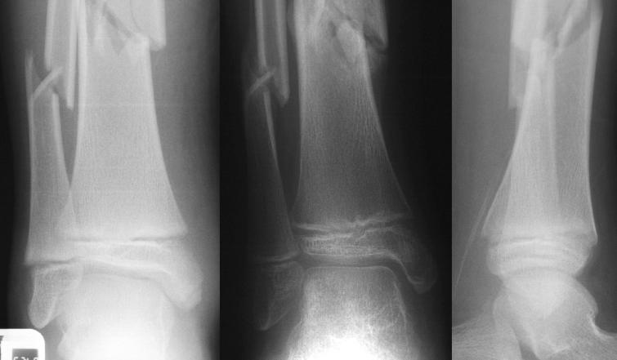

Slide 19
1d. Compound Fracture – break in bone punctures the skin

Slide 20
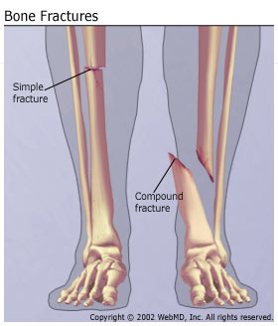

Slide 21
Problems of Skeletal System
2. Osteoporosis –progressive loss of bone tissue
Bones weaken and become brittle
Caused by a lack of vitamin D and calcium
Weight training and physical activity help increase bone mass

Slide 22
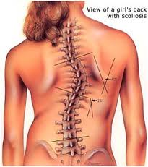
Problems of Skeletal System
3. Scoliosis
curvature of the spine.
Depending on how serious, can be treated by light exercise, a special brace, or surgery.

Slide 23
Problems of the Joints
1. Dislocation – bone slips out of place, tearing the ligaments that attach bone to bone

Slide 24
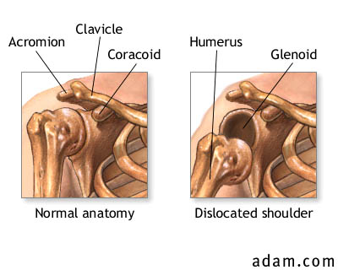

Slide 25
Problems of the Joints
2. Arthritis – inflammation of a joint, resulting from natural wear and tear

Slide 26
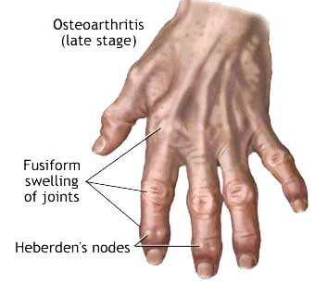
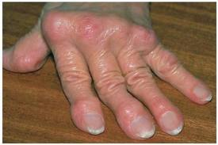
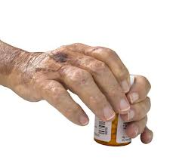

Slide 27
Problems of the Joints
3. Carpal tunnel syndrome – ligaments and tendons in the wrist swell, causing numbness, pain, and weakness in the hand.
Caused by normal wear and tear – typing, writing, etc.

Slide 28
Keeping Skeletal System Healthy
Consume Calcium and Vitamin D!
Participate in regular physical activity
Wear protective gear
Keep teeth clean!!
Infections from cavities can potentially spread to jaw bone and other facial bones.

Slide 29
`

Slide 30
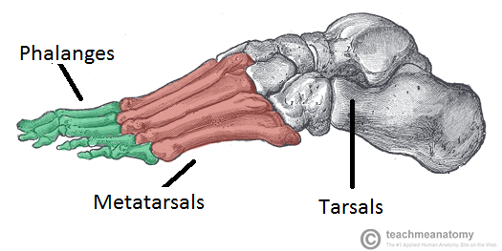
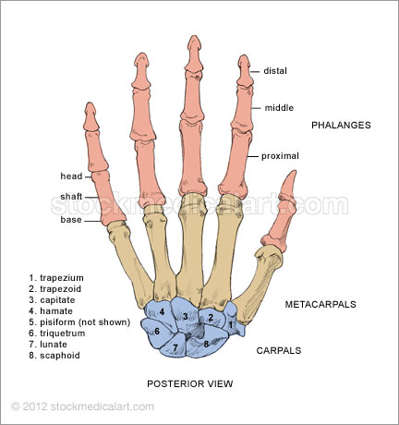
The Foot
The Hand
Color each
Bone a different
color
Carefully cut
Each bone out.
3. Accurately
Glue bones
On construction
Paper.
4. Label bones!

