Slide 1
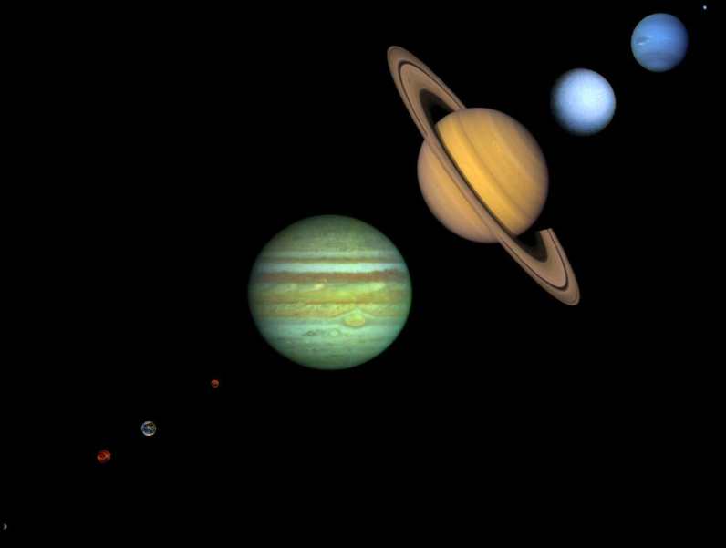
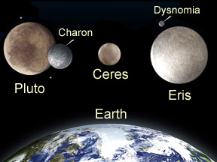
The Solar System
See body of Powerpoint for image sources

Slide 2
Relative Sizes of the Planets, plus Pluto
Neptune
Uranus
Saturn
Not pictured
The dwarf
planet Eris
Jupiter
Mars
Earth
Venus
Mercury
Not pictured, the dwarf planet Ceres
Image from http://www.nineplanets.org/gif/NinePlanets.jpg

Slide 3
Clean picture comparing relative sizes
Image from http://www.nineplanets.org/gif/NinePlanets.jpg

Slide 4
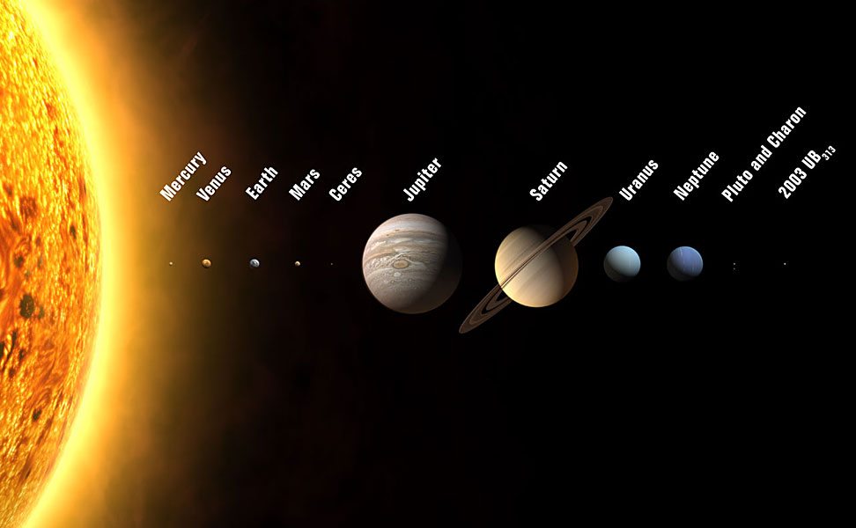
Another perspective
Another perspective
Renamed
Eris
Image from http://media.skyandtelescope.com/images/TwelvePlanets_l.jpg

Slide 5
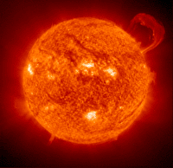
Sun
The Sun is a ___________________at the center of our solar system.
It is estimated to be ____________________________________.
It supports all life on Earth through photo- synthesis and is the ultimate source of all _________________and _____________________________.
It is _________________________________more massive than the Earth (this means that 333,400 Earths can make up the Sun).
______________________________of all the mass of the solar system is found in the Sun.
The core of the Sun is _________________________________.
The surface of the Sun is ______________________________
It takes several hundred thousand years for _____________________ to escape from the dense core and reach the surface.
ADDITIONAL INFORMATION ABOUT NUCLEAR FUSION
Links to Sun sites:
Live from the Sun
StarDate: The Sun
Solar Data Analysis Center
| The Solar System | Sun | Mercury | Venus | Earth | Mars | Jupiter | Saturn | Uranus | Neptune | Pluto (Dwarf Planet)
| Asteroids | Comets | Meteors, Meteoroids, and Meteorites | End Show |

Slide 6
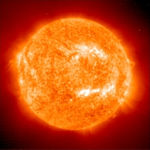
Nuclear Fusion in the Sun
The Sun is basically a huge ball of hydrogen gas held together by the _____________________created by its own mass. Under the intense pressure created at the center of the Sun by gravity, _________________________are fused together to produce _____________________________. Very simply stated, four hydrogen nuclei are fused into one helium nucleus, however one helium atom has _________________________than four hydrogen atoms. The fusion process releases enough _________________________to account for the lost mass.
The ___________________________released by ____________________________in the Sun's core heats the Sun. The hot Sun radiates light into space, warming the Earth and the other planets.
VIDEO
NUCLEAR FUSION IN THE SUN
| The Solar System | Sun | Mercury | Venus | Earth | Mars | Jupiter | Saturn | Uranus | Neptune | Pluto (Dwarf Planet)
| Asteroids | Comets | Meteors, Meteoroids, and Meteorites | End Show |

Slide 7
The Inner Planets
__________________________
__________________________
__________________________
__________________________

Slide 8
Characteristics of the Inner Planets
They are _____________________closest to the sun: Mercury, Venus, Earth and Mars. Located inside Asteroid Belt
Very similar to each other, they are ________________and have ______________________. They are dense. Do ____________________have rings
Often called “_________________________________” because they resemble Earth, “terra-” means “Earth”

Slide 9
Mercury
Size- ______________________of Earth’s diameter
it is 4878 km
Distance from sun- about 39% of Earth’s distance it is 58,000,000 km
Surface- _________________, ___________________________covered with many ___________________and _________________________
Atmosphere- _________________________, some _____________________________and other gases

Slide 10
Mercury(cont’d)
Ability to support life- ___________________________, there is _____________________any sign of life on Mercury, ____________________________________and ________________________along with ____________________temperatures make life unlikely
Moons- none
Rotation- 59 Earth days
Revolution- .24 Earth years
Daytime(sunlit side) temperature 430ºC Nighttime(shaded side) temperature
-190ºC

Slide 11
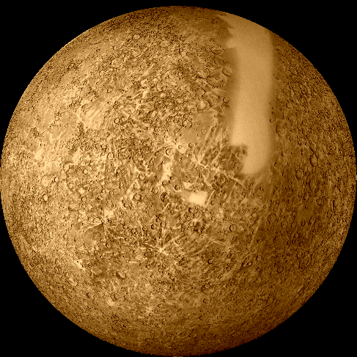
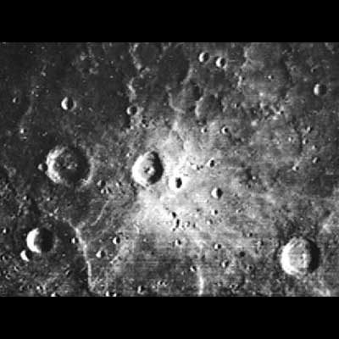
Mercury
Image on right from http://pds.jpl.nasa.gov/planets/images/browse/mercury/mercury1.jpg
Image on left from http://astrogeology.usgs.gov/Projects/BrowseTheSolarSystem/gifs/mercury2.gif

Slide 12
Venus
Size- ______________________________________than Earth
95% of Earth’s diameter, it is 12,104 km
Distance from sun- ____________________________________of Earth’s, it is 108,000,000 km from sun
Surface- covered with ______________________________________________________________________________________________________________, has ____________________________________with lava flows and strange domes

Slide 13
Venus (cont’d)
Atmosphere- ____________________________________________________________________________, mostly ___________________________________________________________________________, clouds partly ____________________________________________
Atmospheric pressure is ____________________________________________________________________________________and would ____________________a human

Slide 14
Venus (cont’d)
Atmosphere continued- ___________________________________________________________________so greenhouse effect is _______________________
Has clouds of _________________________________________
Ability to support life- Life does ___________________appear to exist on Venus, ______________________________along with _____________________________________________ and __________________________________make life on Venus unlikely

Slide 15
Venus (cont’d)
Sometimes called “________________________________________” or “__________________________________________” due to similarity
___________________________________________- rotates “backward” from east to west (opposite of Earth)
Rotates very slowly, one rotation takes __________________________________________________and one revolution around sun takes _________________________________________________(One day is longer than one year)
Moons- None

Slide 16
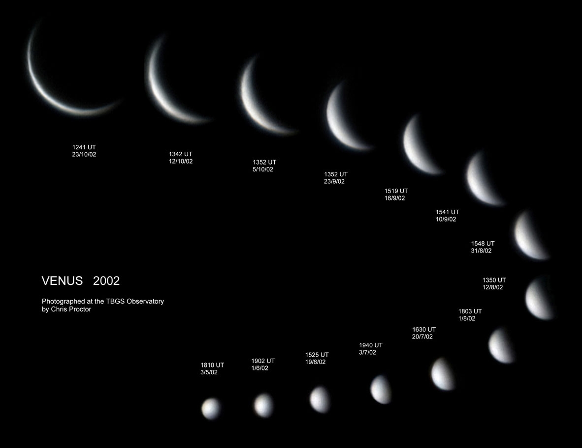
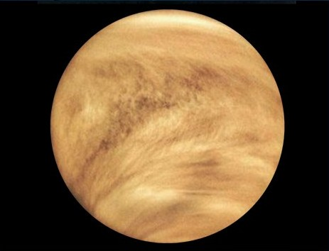
Venus
Phases of Venus Image from http://www.spacestationinfo.com/images/venus-phase1.gif
Image on left from http://rocksfromspace.open.ac.uk/images/venus.jpg

Slide 17
Earth
Size- 12,756 km diameter
Distance from Sun- 150,000,000 km
Surface- Crust is a ____________________________________________________________, __________________is covered by _____________________________
Atmosphere- up to ______________________________, made up of ___________________________________, 21% Oxygen, 1% other gases

Slide 18
Earth
Ability to Support Life- Life ___________________exist on Earth. ________________________________, ___________________________________and ______________________________________ are ________________________for life on Earth
Rotation takes ________________________
Revolution takes _______________________
Earth has ________________moon

Slide 19
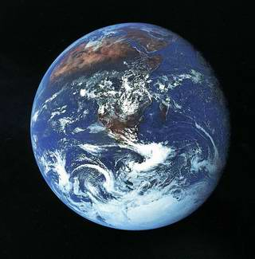
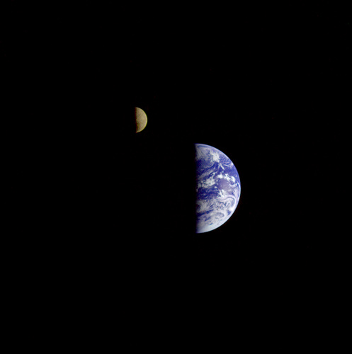
Earth
Image on right from http://z.about.com/d/space/1/7/c/e/earth_moon.jpg
Image on left from http://www.physorg.com/newman/gfx/news/2005/earth12.jpg

Slide 20
Mars
Size- _______________________________________, it is 6794 km
Distance from Sun- about 1.5 times distance of Earth
It is 228,000,000 km from sun
Surface-_________________________________with _______________________________high in _____________, creating red color Polar _________________________contain frozen ___________________________________________.

Slide 21
Mars
Atmosphere- ______________________________, with ____________________________________Mostly ___________________________________, only ___________ of Earth’s atmospheric pressure
Ability to support life- It is possible that _______________________________________________________________________________________________________________or ________________________________________________________________________________. __________________________________________________ makes life on Mars a possibility

Slide 22
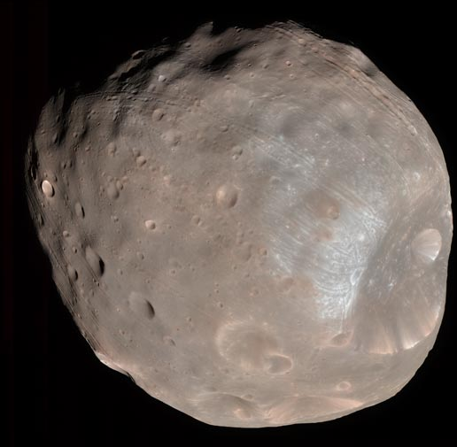
Mars continued
Has ________________________________________________________________________________________________________________
Rotation- 1.03 Earth days
Revolution- 1.9 Earth years
Mars has the ________________________________________________________________________________________________________________
Moons- 2 Phobos and Deimos
Image of Phobos from http://www.nasa.gov/images/content/221818main_PIA10368-516.jpg

Slide 23
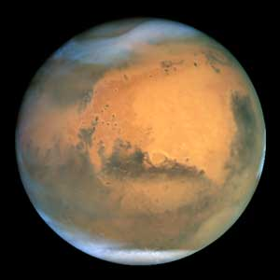
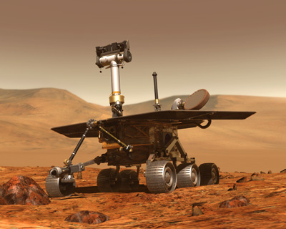
Mars
Image on left from http://www.lunarplanner.com/Images/Mars2003/Mars.jpg
Image on right from http://www.spacetoday.org/images/Mars/MarsRovers2003/MarsRover2003_1.jpg

Slide 24
The Outer Planets
____________________________
____________________________
____________________________
____________________________
____________________________ (a dwarf Planet)

Slide 25
Characteristics of The Outer Planets
These are the planets outside of the _________________________________, they are: _____________________________________________________________________________________________________________________________________________________________________________
Jupiter, Saturn, Uranus, and Neptune are called “_______________________________” . They are much larger than Earth and _______________________________________________________________________

Slide 26
Characteristics of The Outer Planets
_____________________________and ___________________________are small and rocky, like the ____________________________planets.
The gas giants _________________________________________________________________________________________________________________________________________________________________________that are typically about 75% hydrogen, 24% helium, and 1% other elements
Gas giants likely have _____________________________of rock, ice, frozen carbon dioxide and other compounds

Slide 27
Jupiter
Size- ______________________________________________________________________________________________, It is 142,800 km
Distance from Sun- _________________________________________________________________________________________________________. It is 778,000,000 km
Surface and atmosphere of gas and liquid it _________________________________________________________________________________________________________________________
Has a _________________________________________of about 86 % hydrogen,14 % helium, and tiny amounts of methane, ammonia, phosphine, water, acetylene, ethane, germanium, and carbon monoxide.

Slide 28
Jupiter continued
Ability to support life- _______________________________________________________________________________________________________________________________________________________________________________________________________________________
Largest planet in solar system with 300 times the mass of Earth
Rotation- .41 Earth days (fastest)
Revolution- 29 Earth years

Slide 29
Jupiter continued
Moons-53 moons, 16 that are 10 km or larger and many smaller ones(NASA), Europa may have water
Has dark rings
___________________________________________________________________________________________________________________________________________________________________________________________________________________

Slide 30
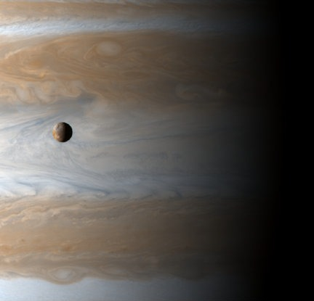
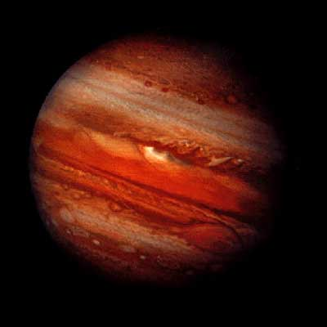
Jupiter
Jupiter and moon Io
Image on left from http://pds.jpl.nasa.gov/planets/images/browse/jupiter/jupiter.jpg
Image on right from http://www.spacetoday.org/images/SolSys/Jupiter/JupiterBelowIo2001.jpg

Slide 31
Saturn
Size- About ________________________________________________________________________________. It is 120,540 km
Distance from sun- About 9.5 times distance from sun as Earth. 1,427,000,000 km
Surface and atmosphere of a gas giant, _______________________________________________________________________________________________________________________________________________________________________________________________________________________________________________________________________________________

Slide 32
Saturn continued
________________________________________________________________________________________________________________________________________________________________________________________________________________________________________________________________________________________
_____________________________ largest planet in solar system
Rotation- 0.43 Earth days
Revolution- 29 Earth years

Slide 33
Saturn continued
Moons- 53 moons
_______________________________________________________________________________________________________________________________________________________________________________
_____________________________________- diameter of 250,000 km or more but only about 1 kilometer thick, ______________________________________________________________________________________________

Slide 34
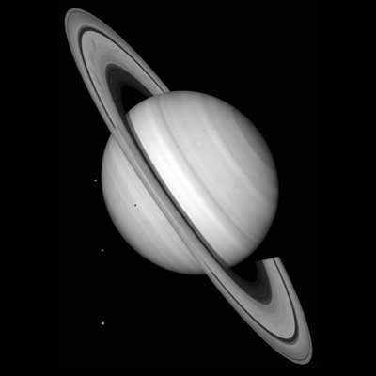
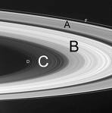
Saturn
Image on right from http://www.adlerplanetarium.org/cyberspace/planets/saturn/images/saturns_ring_plane.jpg
Image on left fromhttp://pds.jpl.nasa.gov/planets/images/full/saturn/saturn.jpg

Slide 35
Uranus
pronounced “YOOR-a-nus”
Size- ____________________________________________________________________________________________________________. It is 51,200 km
Distance from Sun- About 19 times farther from sun than Earth. It is 2,871,000,000 km
________________________________________________________________________________________________________________________________________________________________________________________________________________________________

Slide 36
Uranus continued
the surface of Uranus consists of ________________________________________________________________________________________________________________________________________________________________________________________________________________________________________________________________________________________________________________________________________________
Uranus' atmosphere is about 83% ______________________________, 15% ______________________and 2% _____________________________________.

Slide 37
Uranus continued
________________________________________________________________________________________________________________________________________________________________________________________________________________________________________________________________________________________
Rotation- 0.72 Earth days, is retrograde rotation like Venus, and rotates on side
Revolution- 84 Earth years
Moons- 27 moons- half of them are made of ice
Rings- ___________________________________________________

Slide 38
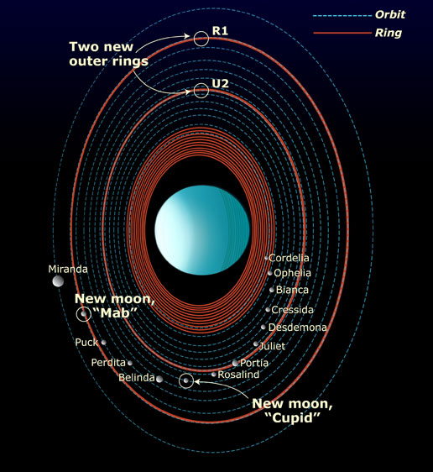
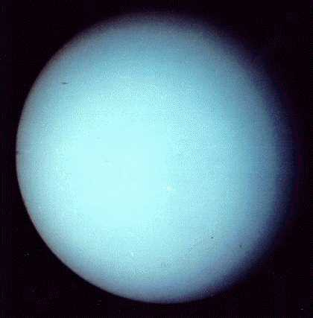
Uranus
Image on left from http://nssdc.gsfc.nasa.gov/planetary/image/uranus.jpg
Image on right from http://www.nasa.gov/images/content/139938main_uranus_ring.jpg

Slide 39
Neptune
Size- _________________________________________________________________. It is 49,500 km
Distance from Sun- Almost 30 times farther from sun than Earth. It is 4,497,000,000 km
_______________________________________________________________________________________________________________
Neptune's composition is probably similar to Uranus': _____________________________________________________ with about 15% _________________________, some ______________________, and a little _______________________

Slide 40
Neptune continued
Atmosphere is mostly __________________________________________________________________________________________________________________________________.
Ability to support life- ________________________________________________________________________________________________________________________________________________________________________________

Slide 41
Neptune continued
Rotation- 0.67 Earth days
Revolution- 165 Earth years
________________________________________________________________________________________
Moons- 13 moons
________________________________________________________________________________________

Slide 42
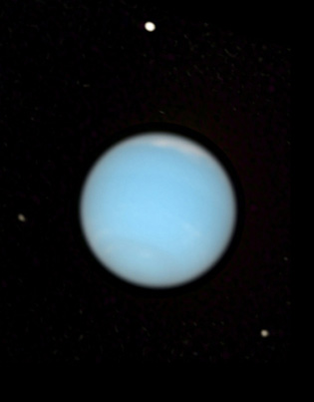
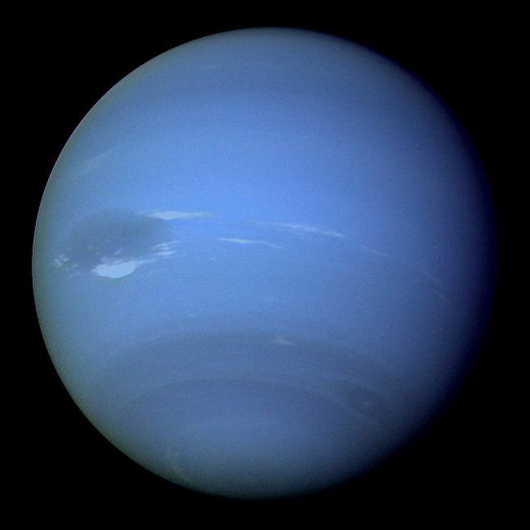
Neptune
Image on left from http://www.diracdelta.co.uk/science/source/n/e/neptune/neptune.jpg
Image on right from http://upload.wikimedia.org/wikipedia/commons/6/63/Neptune-visible.jpg

Slide 43
Pluto
Size- about ____________________________________________________________________________________________. It is 2200 km
Distance from sun- more than 39 times farther than Earth. It is 5,913,000,000 kilometers
________________________________________________________________________________________________________________
________________________________________________________________________________________________________________

Slide 44
Pluto continued
________________________________________________________________________________________________________________________________________________________________________________________________________________________________
Moons- 1 Charon (book), 3- Charon, Hydra and Nix (web and NASA)
Rotation- 6.4 Earth days
Revolution- 248 Earth years

Slide 45
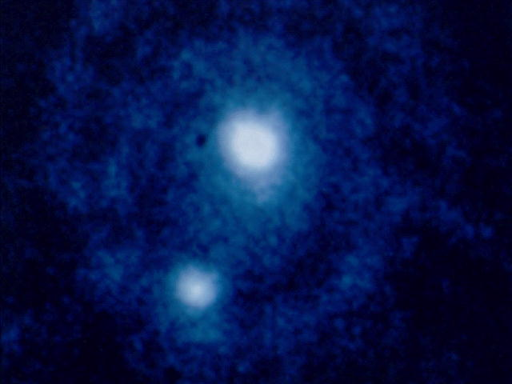
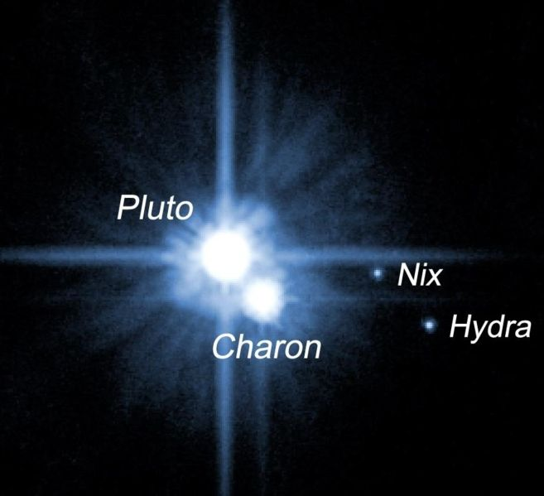
Pluto
Image on left from http://www.crh.noaa.gov/Image/fsd/astro/Pluto1.jpg
Image on right from http://www.jb.man.ac.uk/public/Pluto1.jpg

Slide 46
The Dwarf Planets
_________________________- ________________________________________________________________________________________________________________(it is between Mars & Jupiter). Say sir’eez
_____________________- was classified as a planet, now ________________________________________________________________________________________________________________
_____________________- _______________________________________________________________________________________________________________________. it is an icy body near the edge of our solar system. Say ee’ris

Slide 47
The Dwarf Planets and their Moons
Image from http://www.windows.ucar.edu/our_solar_system/dwarf_planets/images/dwarf_planet_sizes_sm.jpg

Slide 48
Planets and Dwarf Planets compared
Dwarf planets are ______________________________________________________________________________________________________________
Both _________________________________________________
Both are large enough that their ________________________________________________________________________________________________________________
Planets clear smaller objects out of their orbit. Dwarf planets can not because of their weaker gravity
Information from http://www.windows.ucar.edu/tour/link=/our_solar_system/dwarf_planets/dwarf_planets.html

Slide 49
Background info on Dwarf Planets
There are currently ___________________________________________official dwarf planets. Pluto, formerly the smallest of the nine "traditional" planets, was demoted to dwarf planet status. Ceres, the largest asteroid in the main asteroid belt between Mars and Jupiter, was also declared a dwarf planet. The third and final (for now!) dwarf planet is Eris, an icy body on the edge of our Solar System that was discovered recently in 2005. Eris was temporarily labeled 2003 UB313 when it was first discovered, and given the nickname "Xena", before astronomers settled on the official name of Eris.
Text from http://www.windows.ucar.edu/tour/link=/our_solar_system/dwarf_planets/dwarf_planets.html

Slide 50
Background info on Dwarf Planets continued
What's the difference between regular planets and dwarf planets? As you might guess, it's partly an issue of size, with dwarf planets being smaller. But just how big does a planet need to be to become a full-fledged planet instead of a dwarf? You might think the minimum size requirement is arbitrary, but the size cutoff is actually based on other properties of the object and its history in the Solar System. Both planets and dwarf planets orbit the Sun, not other planets (in which case we call them moons). Both must be large enough that their own gravity pulls them into the shapes of spheres; this rules out numerous smaller bodies like most asteroids, many of which have irregular shapes. Planets clear smaller objects out of their orbits by sucking the small bodies into themselves or flinging them out of orbit. Dwarf planets, with their weaker gravities, are unable to clear out their orbits.Though there are just three dwarf planets now, their number is expected to grow. Scientists estimate there may be 70 dwarf planets amongst outer solar system objects that have been discovered already. Since we don't know the actual sizes or shapes of many of the objects we've found (because they are so far away), we can't yet determine whether they are actually dwarf planets or not. More observations and better telescopes will help us determine which other objects are dwarf planets. Astronomers speculate that there may be 200 or so dwarf planets out through the distance of the Kuiper Belt, an icy band of frozen planetoids on the edge of our Solar System.
Text from http://www.windows.ucar.edu/tour/link=/our_solar_system/dwarf_planets/dwarf_planets.html

Slide 51
Additional Sources
http://www.windows.ucar.edu/tour/link=/our_solar_system/dwarf_planets/dwarf_planets.html
http://www.pantheon.org/miscellaneous/pronunciations.html
http://www.nasa.gov
http://www.nineplanets.org

