Slide 1
The Muscular System

Slide 2
1. What do muscles do?
a. allows movement
b. enables voluntary and involuntary movement
c. voluntary – movements you can control
ex. Shooting a basketball, playing piano, etc.
d. involuntary – occurs without you knowing it
ex. Muscles that help you breathe, make your heartbeat

Slide 3
2. 3 Types of Muscle
a. Smooth Muscle – acts on the lining of the body’s passageways and hollow internal organs
- found inside digestive tract, lining of blood vessels
- INVOLUNTARY – you cannot control the movement!

Slide 4
2. Types of Muscles
b. Skeletal Muscle – muscles attached to bone that cause body movements.
- VOLUNTARY control!

Slide 5
2. Types of Muscles
- Skeletal muscles often work together to perform contrasting movements
- Flexor – muscle that closes a joint
- Extensor – muscle that opens a joint
- a great example is when you bend and straighten your arm at the elbow using your biceps and triceps.

Slide 6
2. Types of Muscles
c. Cardiac Muscle – muscle that forms the walls of the heart
- responsible for the contraction of your heart
- INVOLUNTARY!

Slide 7
Properties of Muscles
1. Contractibility – muscles have the ability to shorten, or contract
2. Extensibility – muscles lengthen

Slide 8
3. How do you build strong muscles?
a. Exercise regularly!
b. Eat foods that are high in protein
Protein – building blocks of muscle
- meats, milk, eggs, yogurt, fish, nuts
c. exercise the right way, use the weight room correctly

Slide 9
Problems of Muscular System
1. Muscle Strain
a. painful stretching or tearing of muscle fibers caused by overexertion
b. to heal, ice it and then apply heat

Slide 10
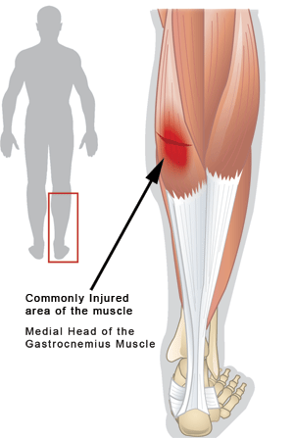
Muscle Strain

Slide 11
Problems of Muscular System
2. Muscle Cramp
a. when a muscle contracts involuntarily
b. may occur from using a muscle for too long
c. to heal - gently stretch muscle and massage the knot

Slide 12
Problems of Muscular System
3. Muscular Dystrophy
a. crippling disease characterized by progressive wasting away of skeletal muscles
b. muscle cells are unable to function properly
c. symptoms – muscle weakness, difficulty standing/walking, frequent falling
d. cannot be cured, but early detection is key as muscle weakening can be delayed

Slide 13
Muscle Size
4. Key Facts and Terms
a. Hypertrophy – increase in muscle size due to exercise
b. Atrophy – decrease in muscle size from a lack of use of muscles

