Slide 1
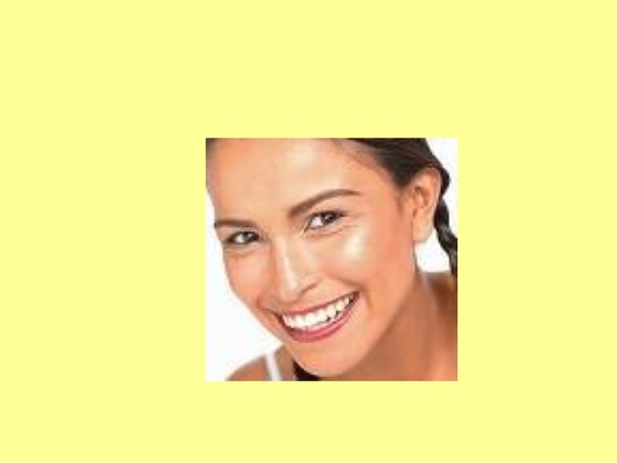
The Skin

Slide 2
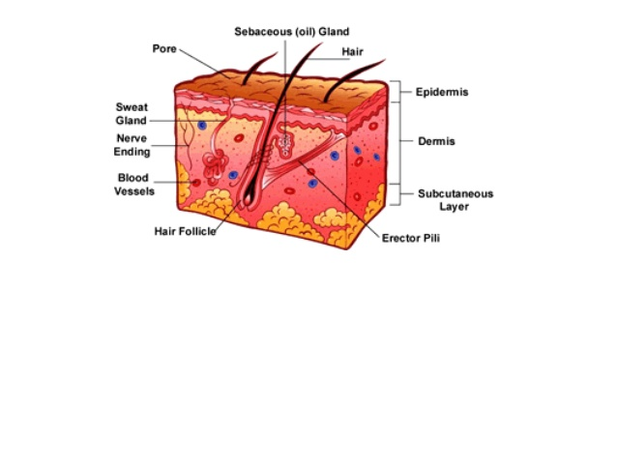
Skin is the __________________organ
__________________functions
Integument or ___________________________
Layers

Slide 3
Vocabulary
________________________= Skin
Dermatology
Study of skin
Dermatitis
Inflammation of skin
_______________________= upon
Epidermis
Top layer of skin
_______________________= pertaining to blood or lots of blood supply

Slide 4
Function of Skin
__________________- protects from germs, dehydration, injury. ___________________________of defense.
Regulates _______________________________
Manufactures ___________________________
Site of many ____________________________

Slide 5
Temporary ________________________________________________________________________________________________________________________
Protects from ____________________________
Can _______________________________________________________
Ointment

Slide 6
Skin- 3 Basic Layers
_____________________________- epithelial cells with no blood
Avascular
_____________________________- true skin made of connective tissue and is vascular
_____________________________-aka subcutaneous. Attaches integument to muscle.

Slide 7
One Square Centimeter of Skin Contains
3,000,000 cells
10 hairs
1 yard of blood vessels
4 yards of nerves
700 sweat glands
200 nerve endings to record pain
3,000 sensory cells at the end of nerve fibers

Slide 8
Epidermis-the layer on top
Even the epidermis has ______________________!
Very ___________________layer is dead skin cells. Called ___________________________________.
_________________________you.
Every minute of the day we lose about 30,000 to 40,000 dead skin cells off the surface of our skin.
Very ___________________________layer of the epidermis ________________________________by undergoing continuous cell division. Called __________________________________________

Slide 9
Dermis- Thicker Inner Layer of Skin
Matted masses of :
___________________________
___________________________
__________________________
________________________
________________________
__________________________________________________________________

Slide 10
Dermis contains lots of ______________________
Heat, cold, pain, and pressure
___________________________ regulate body temperature
Expand or contract
____________________________________
Lubricated, protected, waterproof
_______________________________________
Cools, protects
Collagen and elastin
________________________cells

Slide 11
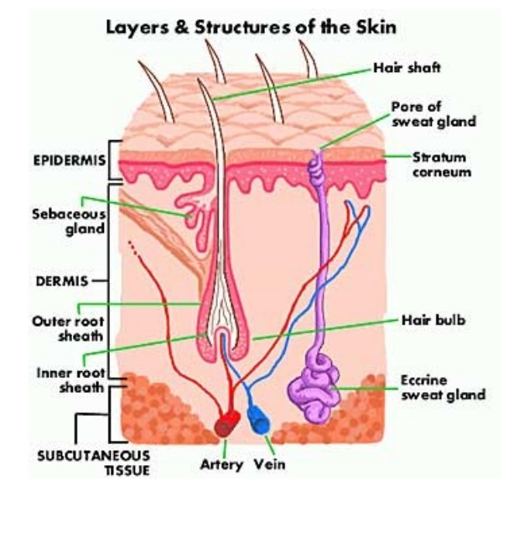
Subcutaneous…aka Hypodermis
Loose _________________________________
Connects the ________________________________________________________________________________
__________________________________
_________________________________
Has many ______________________________________________________________________________

Slide 12
Fat cells ____________________________after puberty—as your body stores more fat, the number of fat cells remains the same. Each fat cell simply ________________________________.
Fat cells are large cells that have very little cytoplasm, only 15% cell volume, a small nucleus and one large fat droplet that makes up 85% of cell volume.

Slide 13
Diseases of the Skin

Slide 14
Diseases of the Skin
1.) ________________________-a common and chronic disorder of the sebaceous glands
2.) __________________________________- a contagious fungal infection of the epidermis
3.) ___________________________- a nonspecific inflammation of the skin
4.) ______________________________- the chronic inflammatory skin disease. Cause unknown. No definitive treatment.

Slide 15
Acne
Fine hair follicles become _____________________________________________________________________________(oily matter)
Mixture of oil and cells allows ________________________________________________________________________________________
____________________________________________and attract white blood cells that ________________________________________________________________________________________________

Slide 16
Athlete’s Foot
Also known as _____________________________________
______________________________________________________________________on human skin, especially the feet.
It ________________________________________________________________________________________________. A foot inside a show is the perfect place for the fungus to grow.

Slide 17
Dermatitis
Contact dermatitis is characterized by _____________________________________________________________________________________________________________________________________________________________________________________________________________________________________________________
Irritants include detergents, soaps, disinfectants, fragrances, plants

Slide 18
Psoriasis
______________________________________________
______________________________________________ covered by a silvery-white scale
The skin often itches, and it may crack and bleed
More than 4.5 million adults in the U.S. have been diagnosed with psoriasis.
Your ______________________________________________________________________________________and end up causing an inflammation

Slide 19
Skin Cancer
________________________________________________________________________________________
Associated with ________________________________________________________________________________________
Other factors
__________________________________________
__________________________________________

Slide 20
Types of skin cancer
__________________________________________- Most common, least dangerous. Starts in the epidermis and extends to the dermis or subcutaneous later. 99% recover.
___________________________________________- Starts in the epidermis. Occurs most frequently on scalp and lower lip. Grows quickly, can spread to lymph nodes. Chances of recovery are good if caught early.

Slide 21
__________________________________________________– occurs in pigmented cells of the skin called melanocytes
Spreads quickly to other areas. _________________________________________________. Treatment is surgical removal and chemotherapy.

