Slide 1
The Skin

Slide 2
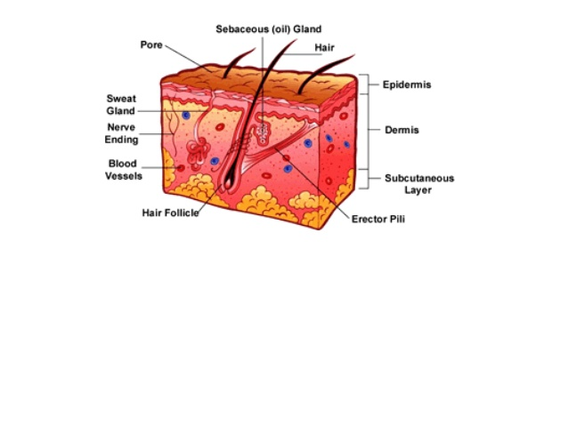
Skin is the largest organ
Many functions
Integument or Integumentary System
Layers

Slide 3
Vocabulary
Derma = Skin
Dermatology
Study of skin
Dermatitis
Inflammation of skin
Epi = upon
Epidermis
Top layer of skin
Vascular = pertaining to blood or lots of blood supply

Slide 4
Function of Skin
Cover - protects from germs, dehydration, injury. First line of defense.
Regulates body temperature
Manufactures Vitamin D
Site of many nerve endings

Slide 5
Temporary storage of glucose, fat, water and salt.
Protects from UV radiation
Can absorb chemical substances
Ointment

Slide 6
Skin- 3 Basic Layers
Epidermis- epithelial cells with no blood
Avascular
Dermis- true skin made of connective tissue and is vascular
Hypodermis -aka subcutaneous. Attaches integument to muscle.

Slide 7
One Square Centimeter of Skin Contains
3,000,000 cells
10 hairs
1 yard of blood vessels
4 yards of nerves
700 sweat glands
200 nerve endings to record pain
3,000 sensory cells at the end of nerve fibers

Slide 8
Epidermis-the layer on top
Even the epidermis has layers!
Very top layer is dead skin cells. Called Stratus Corneum.
Protects you.
Every minute of the day we lose about 30,000 to 40,000 dead skin cells off the surface of our skin.
Very bottom layer of the epidermis produces more cells by undergoing continuous cell division. Called Stratus Germinativum.

Slide 9
Dermis- Thicker Inner Layer of Skin
Matted masses of :
Connective tissue
Elastic fibers
Nerve endings
Muscles
Hair follicles
Oil and sweat glands

Slide 10
Dermis contains lots of sensory cells
Heat, cold, pain, and pressure
Blood vessels regulate body temperature
Expand or contract
Sebaceous glands
Lubricated, protected, waterproof
Sweat glands
Cools, protects
Collagen and elastin
Immune cells

Slide 11
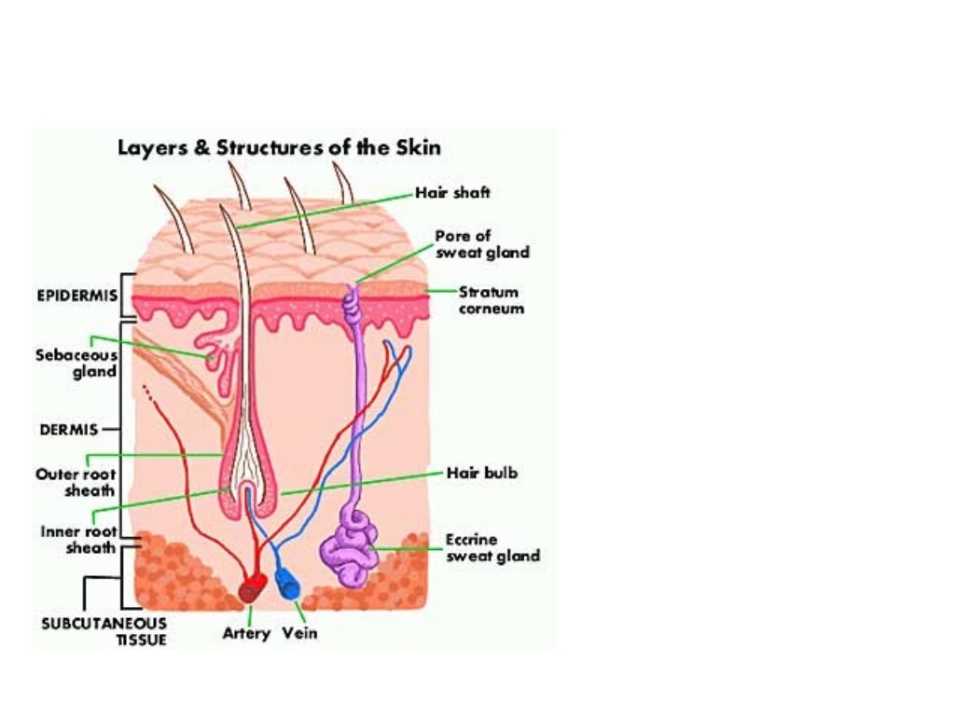
Subcutaneous…aka Hypodermis
Loose connective tissue and fat
Connects the integumentary system to muscle
Insulates
Absorbs shock
Has many blood vessels

Slide 12
Fat cells do not multiply after puberty—as your body stores more fat, the number of fat cells remains the same. Each fat cell simply gets bigger.
Fat cells are large cells that have very little cytoplasm, only 15% cell volume, a small nucleus and one large fat droplet that makes up 85% of cell volume.

Slide 13
Diseases of the Skin

Slide 14
Diseases of the Skin
1.) Acne- a common and chronic disorder of the sebaceous glands
2.) Athlete’s Food- a contagious fungal infection of the epidermis
3.) Dermatitis- a nonspecific inflammation of the skin
4.) Psoriasis- the chronic inflammatory skin disease. Cause unknown. No definitive treatment.

Slide 15
Acne
Fine hair follicles become plugged with sebum (oily matter)
Mixture of oil and cells allows bacteria to grow in the plugged follicles
Bacteria produce chemicals and enzymes and attract white blood cells that cause inflammation

Slide 16
Athlete’s Foot
Also known as tinea pedis
Fungal infection that can grow and multiply on human skin, especially the feet.
It grows best in a dark, moist, and warm environment. A foot inside a show is the perfect place for the fungus to grow.

Slide 17
Dermatitis
Contact dermatitis is characterized by redness, swelling, itching, and scaling caused by an allergic substance that make direct contact with the skin.
Irritants include detergents, soaps, disinfectants, fragrances, plants

Slide 18
Psoriasis
Inflammatory skin condition
Patches of raised reddish skin covered by a silvery-white scale
The skin often itches, and it may crack and bleed
More than 4.5 million adults in the U.S. have been diagnosed with psoriasis.
Your T-cells behave as if they are fighting an infection and end up causing an inflammation

Slide 19
Skin Cancer
Most common type of cancer
Associated with exposure to ultraviolet light
Other factors
Heredity
Chemical exposure

Slide 20
Types of skin cancer
Basal cell carcinoma- Most common, least dangerous. Starts in the epidermis and extends to the dermis or subcutaneous later. 99% recover.
Squamous cell carcinoma- Starts in the epidermis. Occurs most frequently on scalp and lower lip. Grows quickly, can spread to lymph nodes. Chances of recovery are good if caught early.

Slide 21
Malignant melanoma – occurs in pigmented cells of the skin called melanocytes
Spreads quickly to other areas. Most deadly. Treatment is surgical removal and chemotherapy.

